Slide 1
Robust Decision Making Via Free Energy Minimization
Code Walk-through
Arash Shafiei , Hozefa Jesawada, Karl Friston, and Giovanni Russo

Slide 2
Outline
Resolution Engine
Robot Experiments
Code Structure
Dynamics Model
Cost Function
Ambiguity Radius and Cost of Ambiguity
Policy Computation
In-silico and Experimental Results
Belief Update
Notes:
The Presentation outline:
Resolution Engine
Robot Experiments
Code Structure
Dynamics Model
Cost Function
Ambiguity Radius and Cost of Ambiguity
Policy Computation
In-silico and Experimental Results
Belief Update

Slide 3
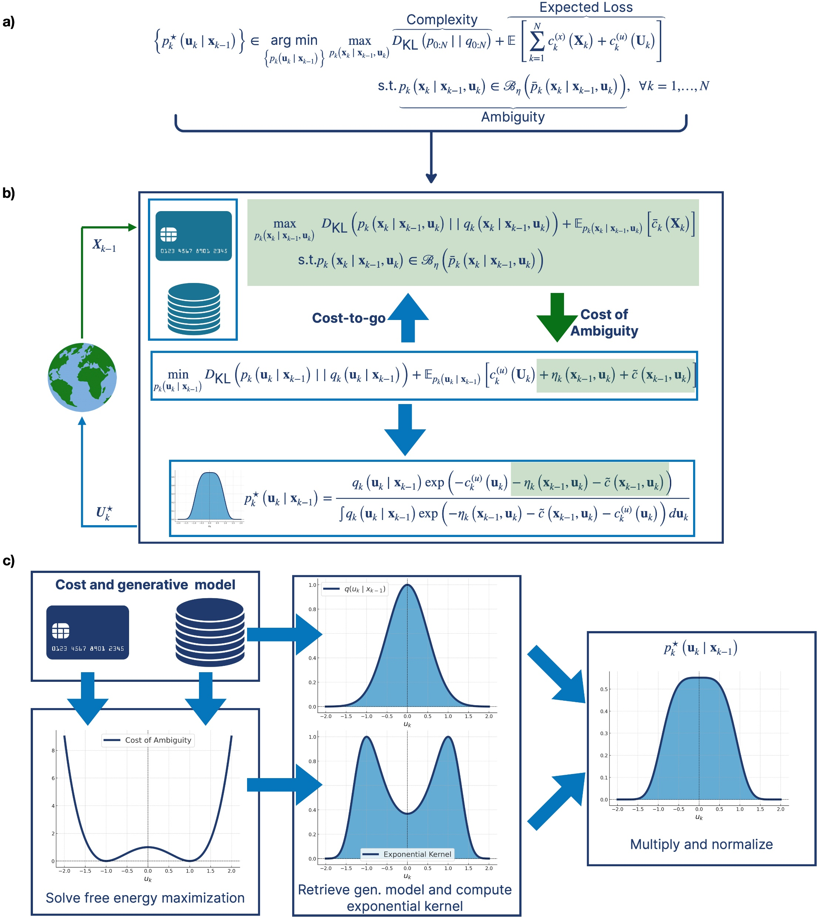
Resolution Engine
Notes:
The problem we want to solve: min max problem
Then: explain cost-to-go
The: highlight eta

Slide 4
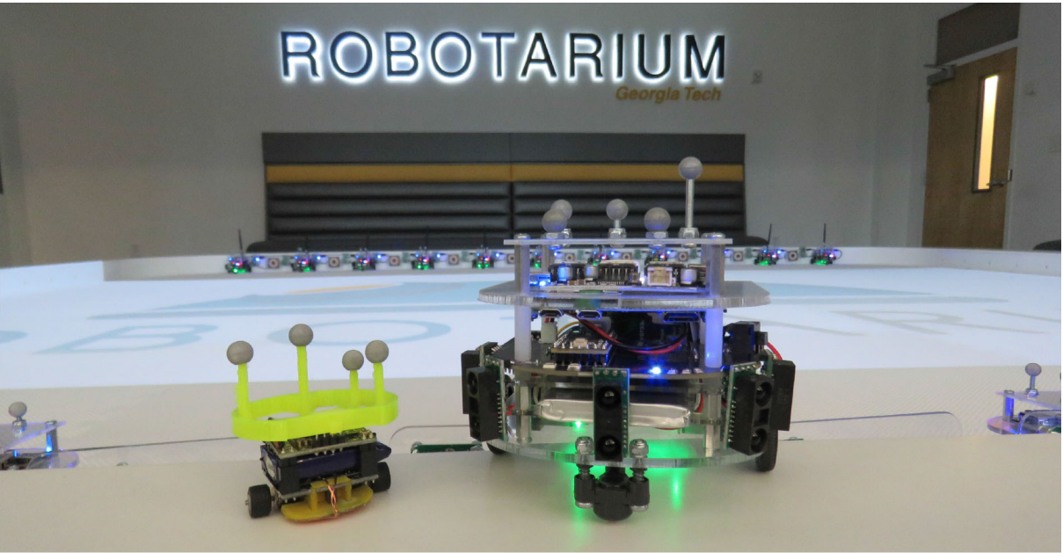
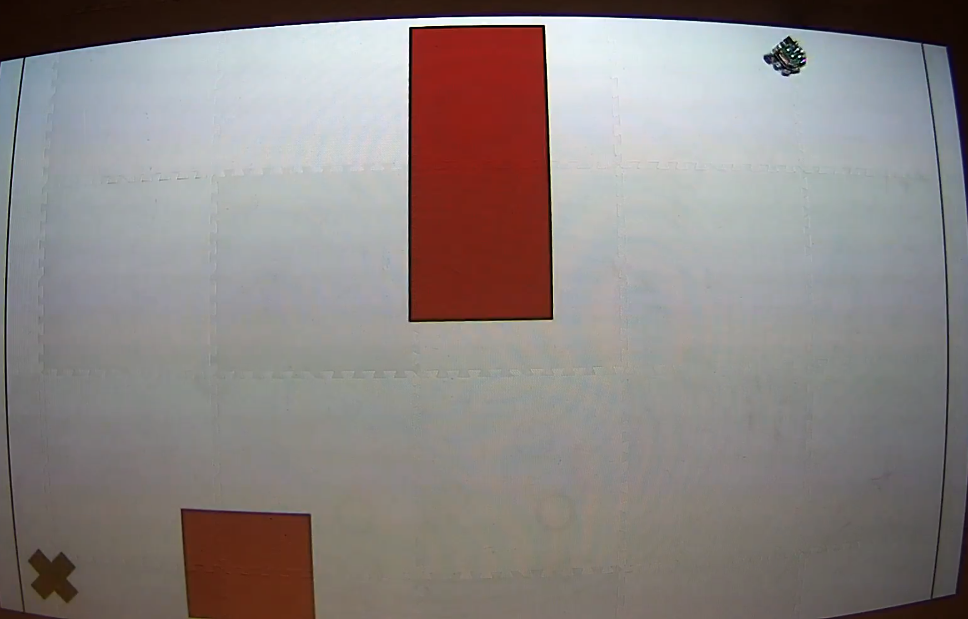
Robot Experiments

Slide 5
Robot Experiments Code Structure
Robot Routing Simulation Code Structure
Define Global Variables and Action Space
Load Trained Dynamics Model
Define Cost Function and Features
Policy Computation
Robot Routing Task and Visualization
Store state input data

Slide 6
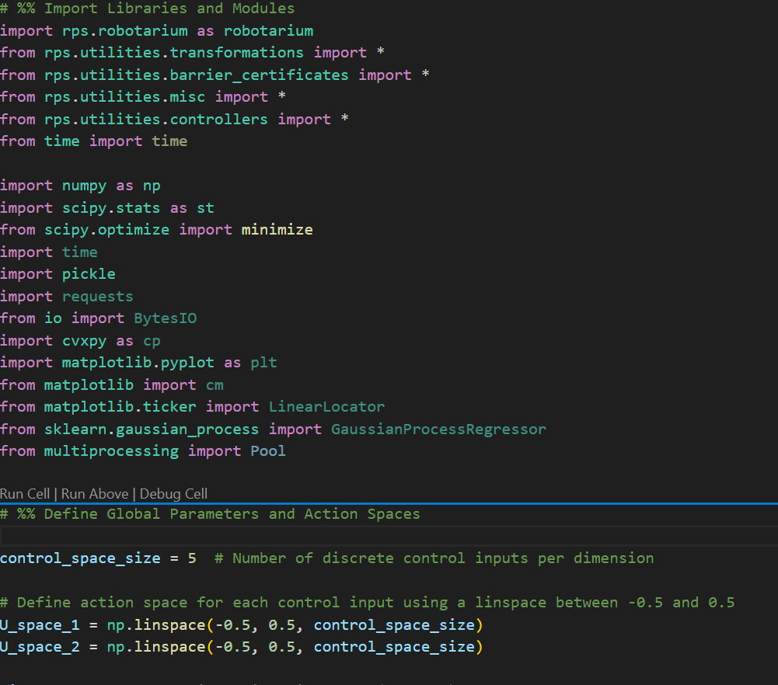
Robot Experiments Code Structure
Robot Routing Simulation Code Structure
Define Global Variables and Action Space
Load Trained Dynamics Model
Define Cost Function and Features
Policy Computation
Robot Routing Task and Visualization
Store state input data

Slide 7
Robot Experiments Code Structure
Robot Routing Simulation Code Structure
Define Global Variables and Action Space
Load Trained Dynamics Model
Define Cost Function and Features
Policy Computation
Robot Routing Task and Visualization
Store state input data

Slide 8
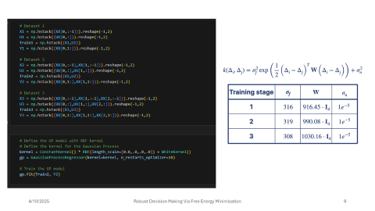
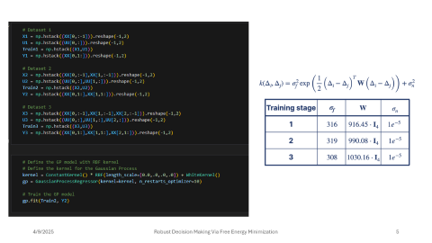
Robot Routing Simulation Code Structure
Define Global Variables and Action Space
Load Trained Dynamics Model
Define Cost Function and Features
Policy Computation
Robot Routing Task and Visualization
Store state input data

Slide 9
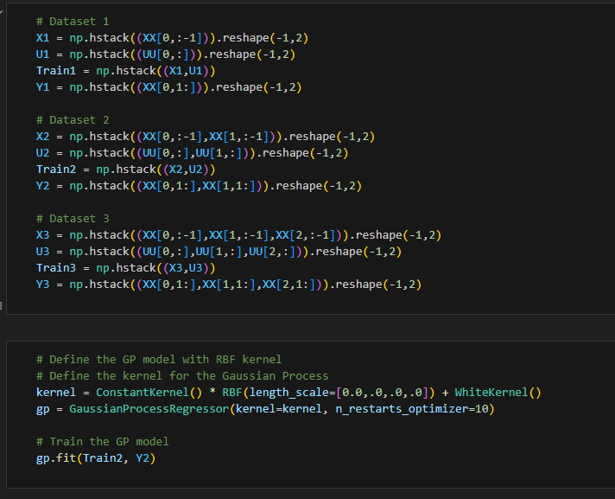
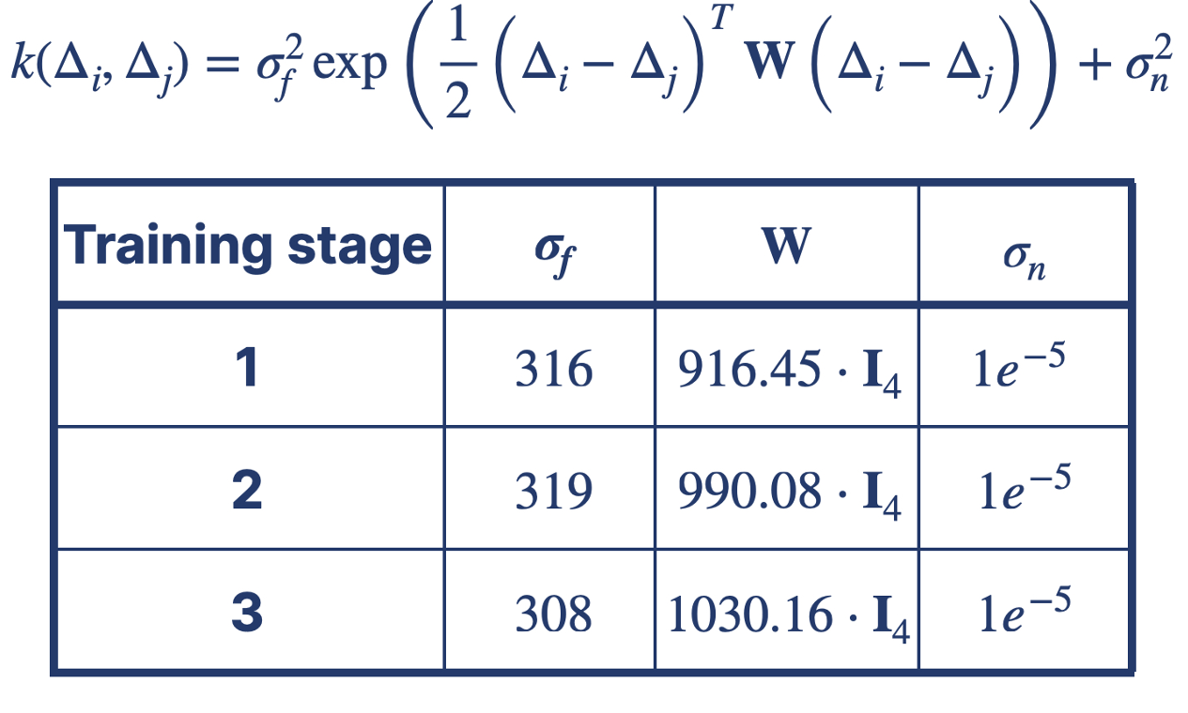

Slide 10
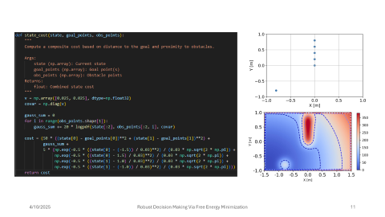
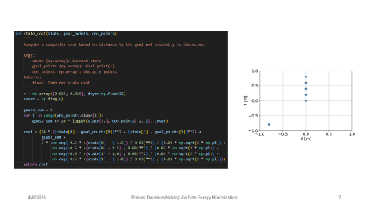
Robot Routing Simulation Code Structure
Define Global Variables and Action Space
Load Trained Dynamics Model
Define Cost Function and Features
Policy Computation
Robot Routing Task and Visualization
Store state input data

Slide 11
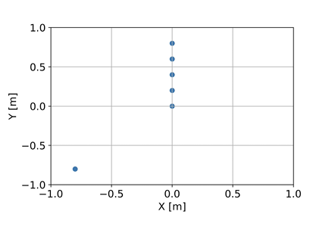
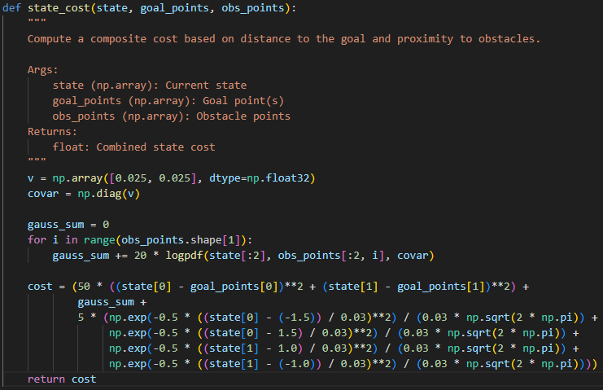
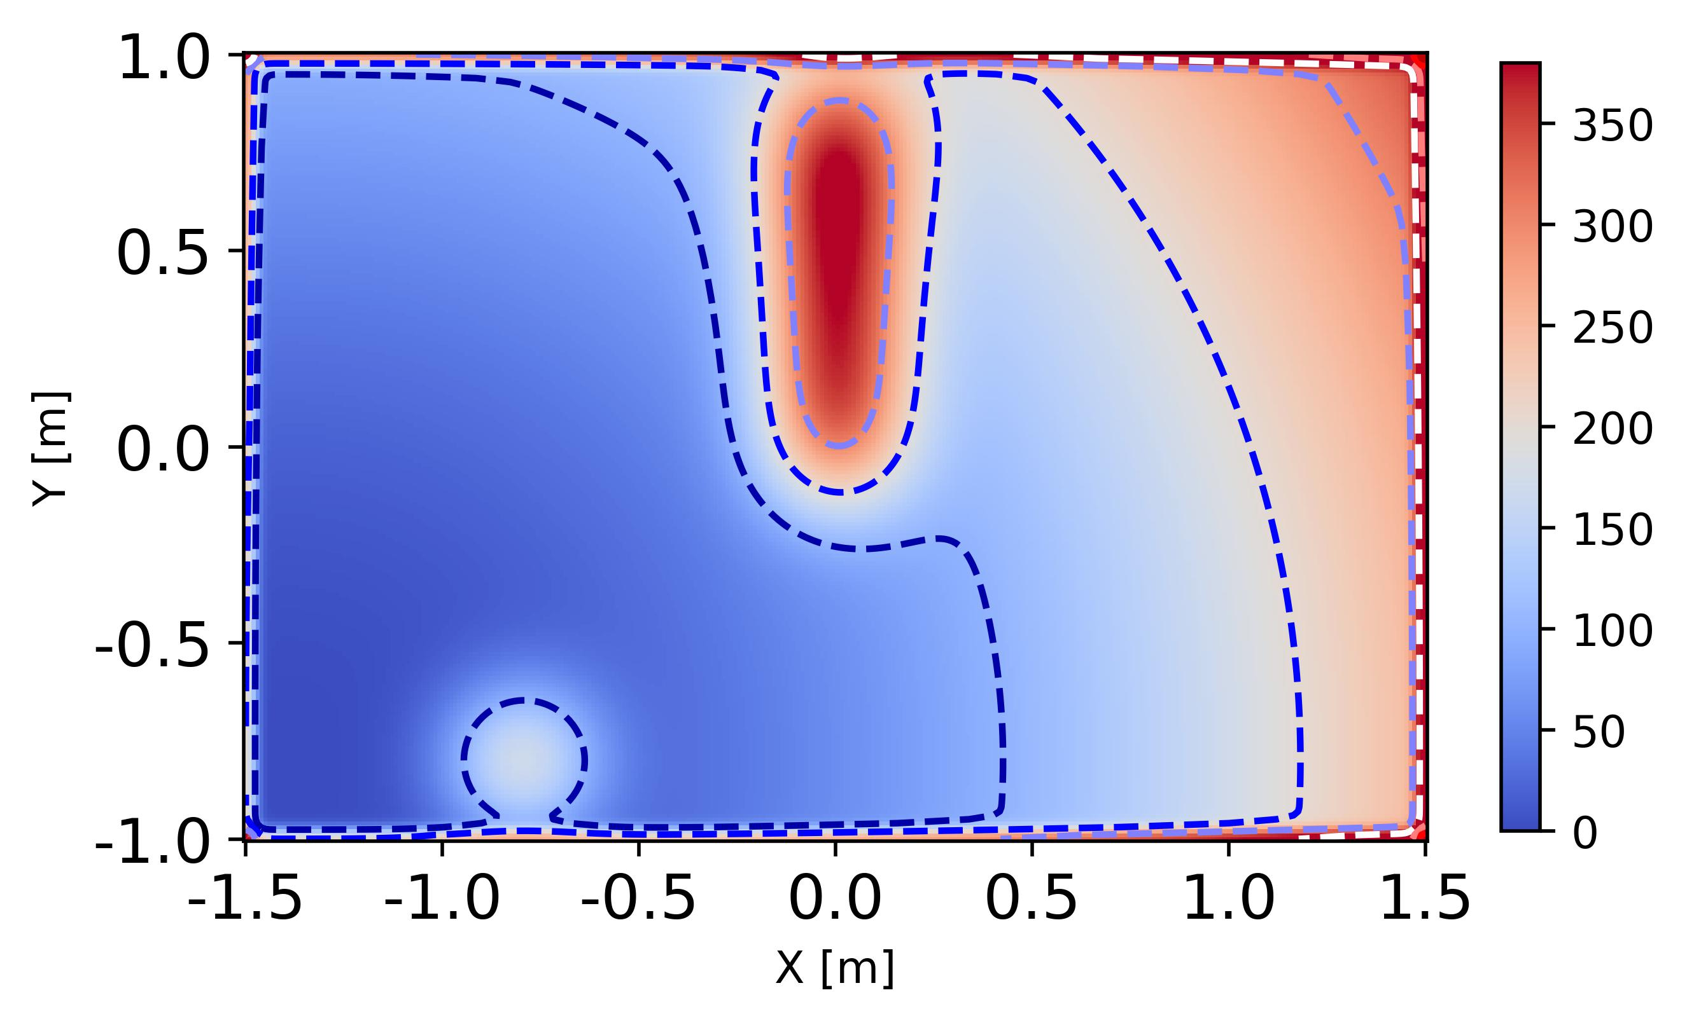

Slide 12
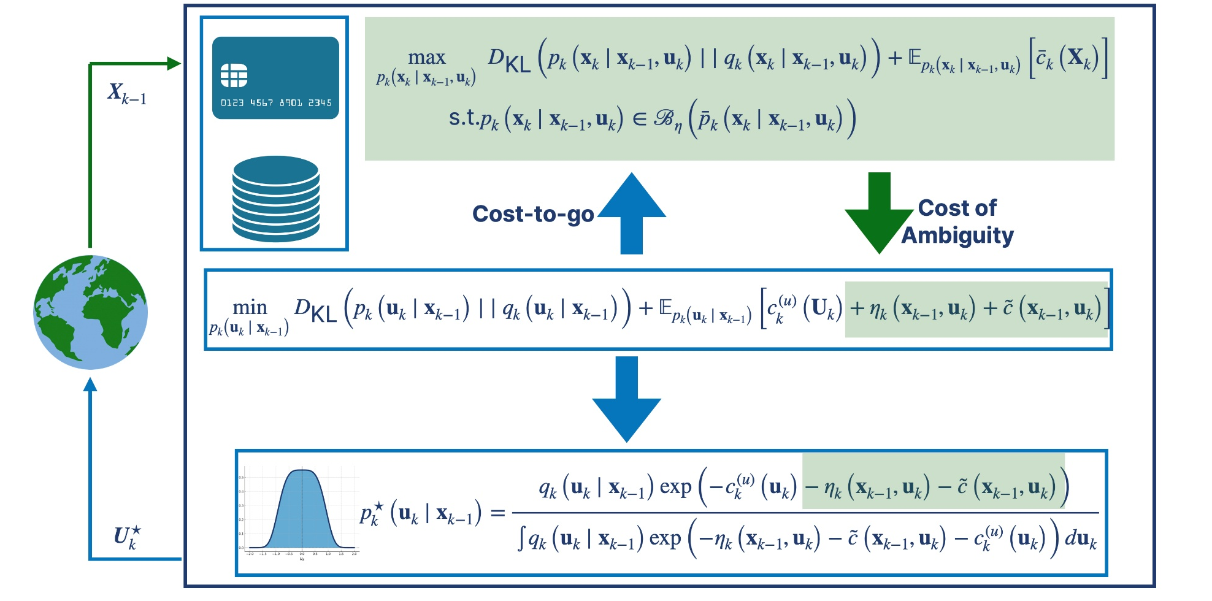
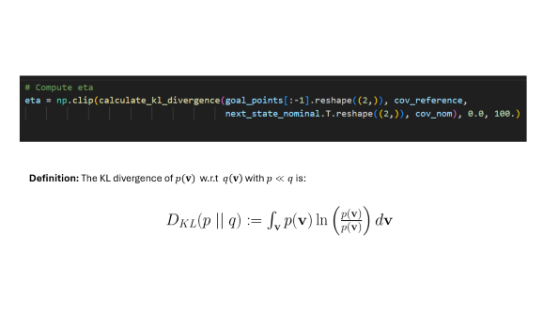
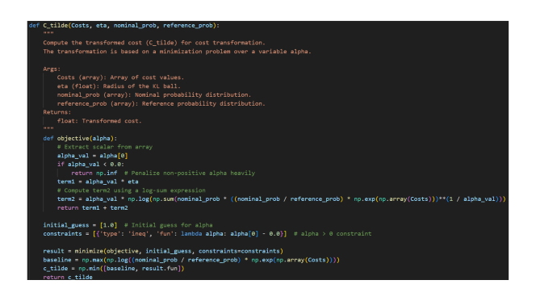
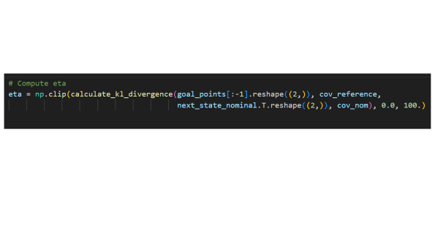

Slide 13
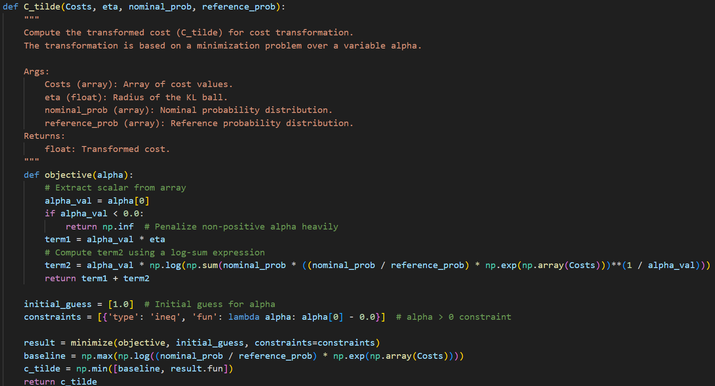

Slide 14
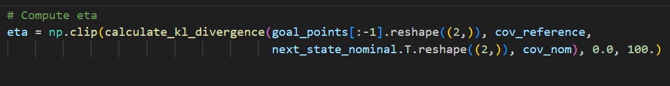
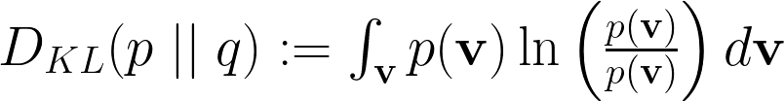
Definition: The KL divergence of $p(v)$ w.r.t $q\left(v\right)$ with $p≪q$ is:

Slide 15
Robot Routing Simulation Code Structure
Define Global Variables and Action Space
Load Trained Dynamics Model
Define Cost Function and Features
Policy Computation
Robot Routing Task and Visualization
Store state input data

Slide 16
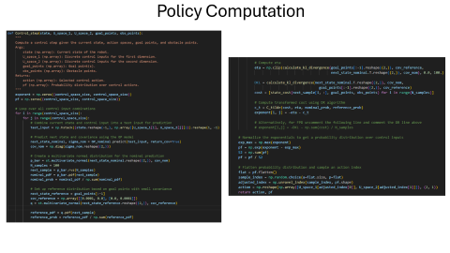
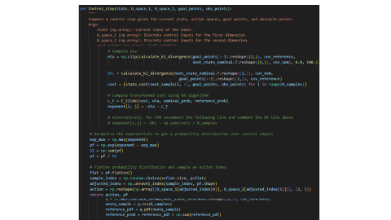

Slide 17
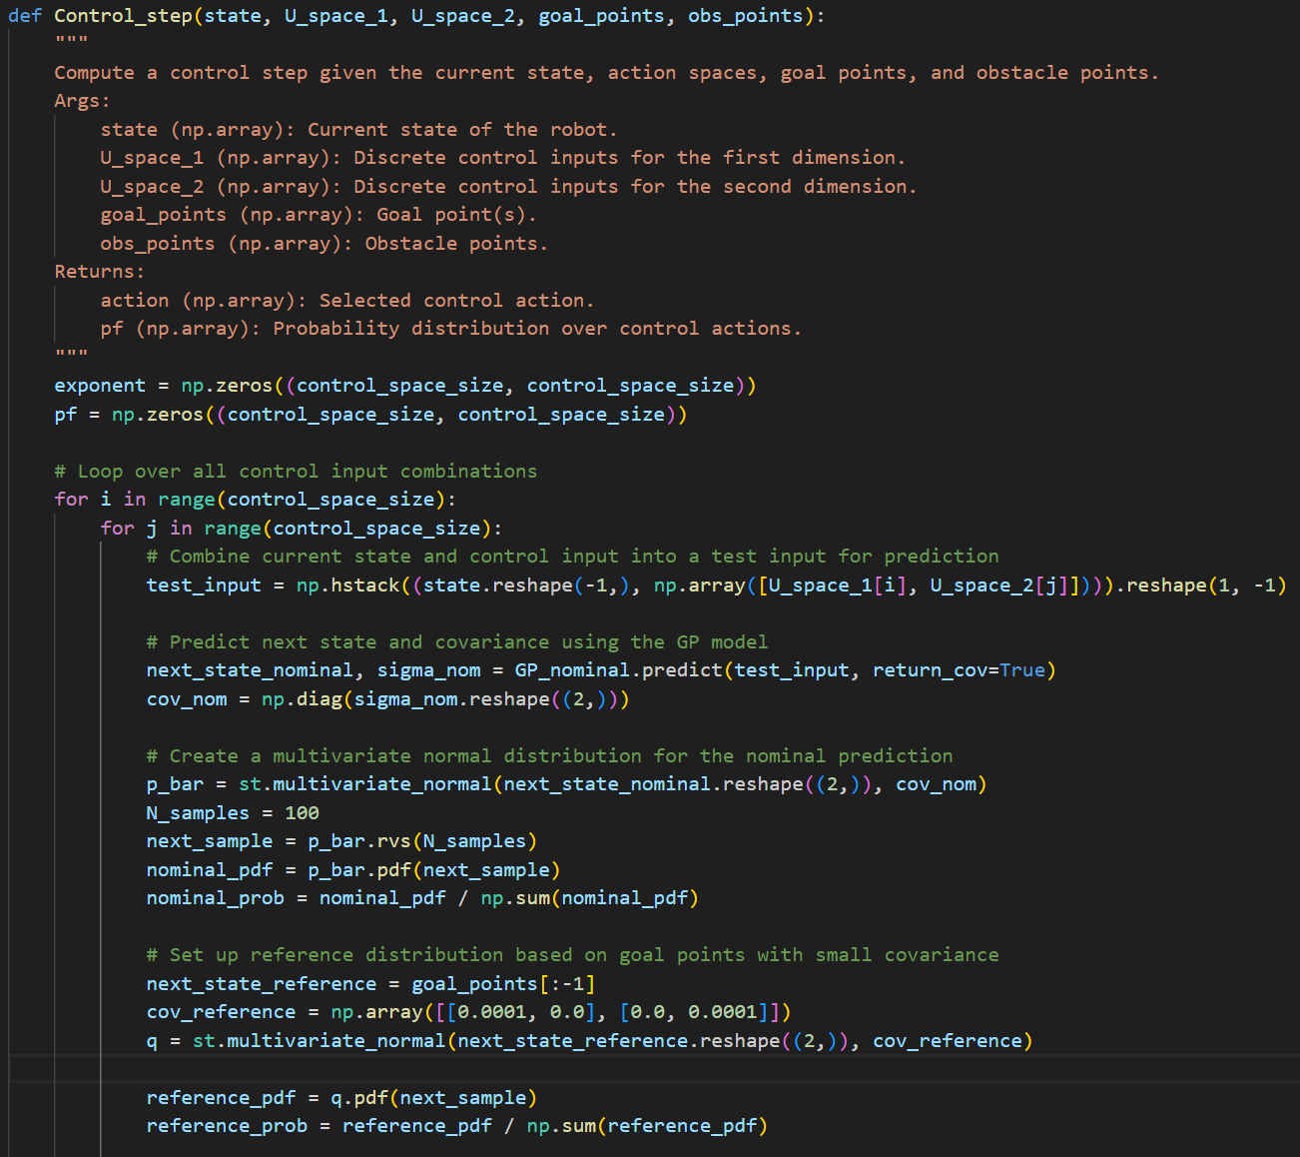
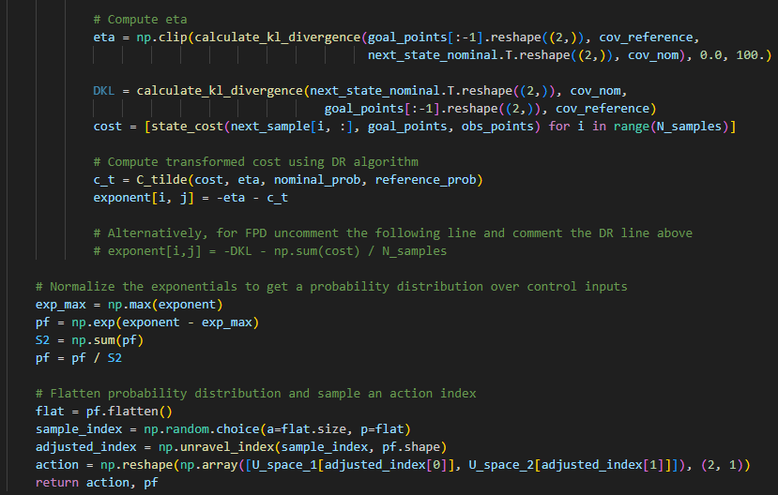
Policy Computation

Slide 18
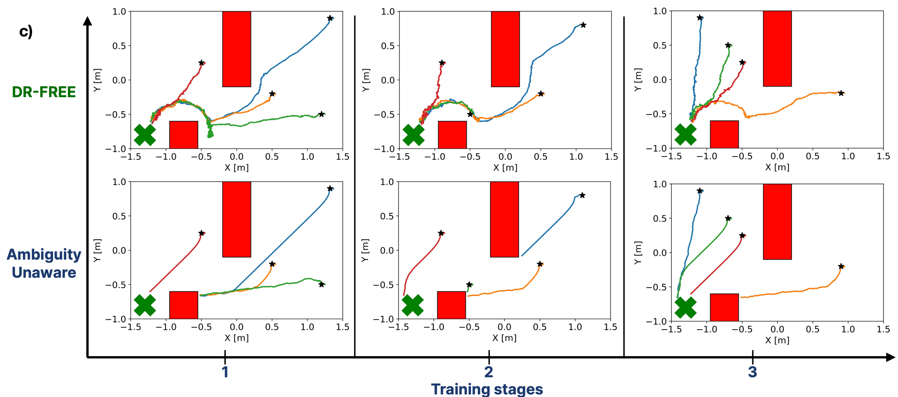

In-Silico and Experimental Results

Slide 19
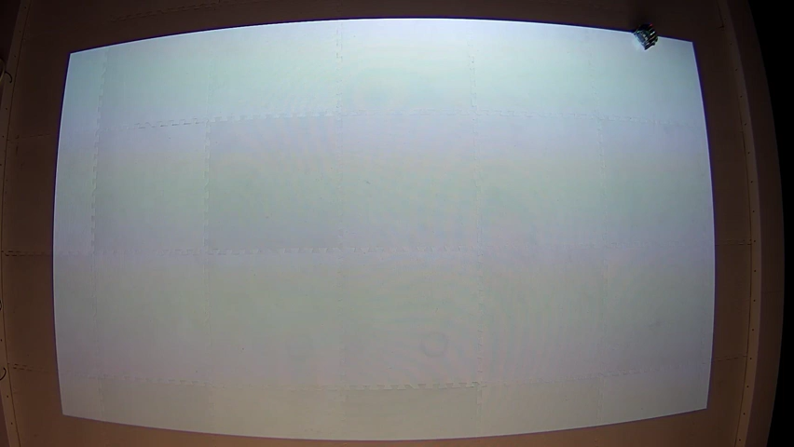
In-Silico and Experimental Results

Slide 20
Belief Update
The optimization problem we solve for belief update:
Cost Feature
Feature Weight

Slide 21
Belief Update
Belief Update Code Structure
Define Global Variables and Action Space
The optimization problem we solve for belief update:
Load Trained Dynamics Model and Expert Agent Data
Define Cost Features
Cost Feature
Feature Weight
Compute Feature Expectation
Formulate and Solve Optimization Problem
Obtain Reconstructed Cost

Slide 22
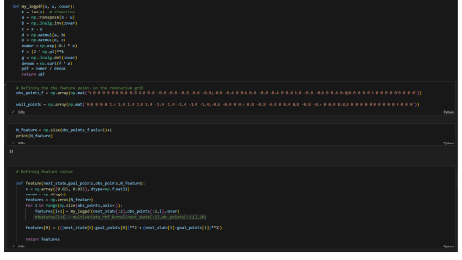
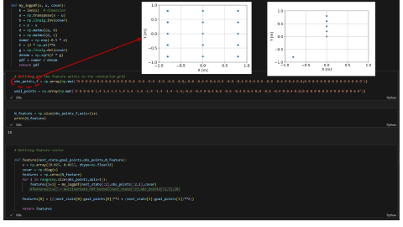
Belief Update
The optimization problem we solve for belief update:

Slide 23
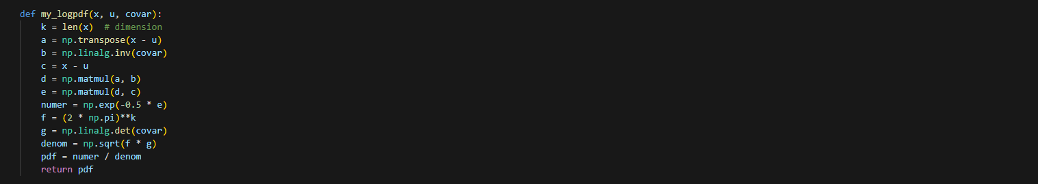
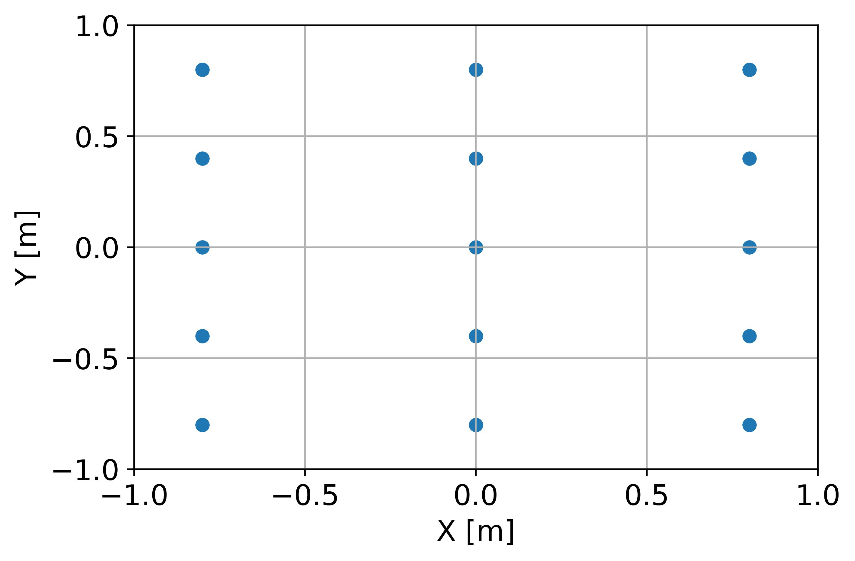
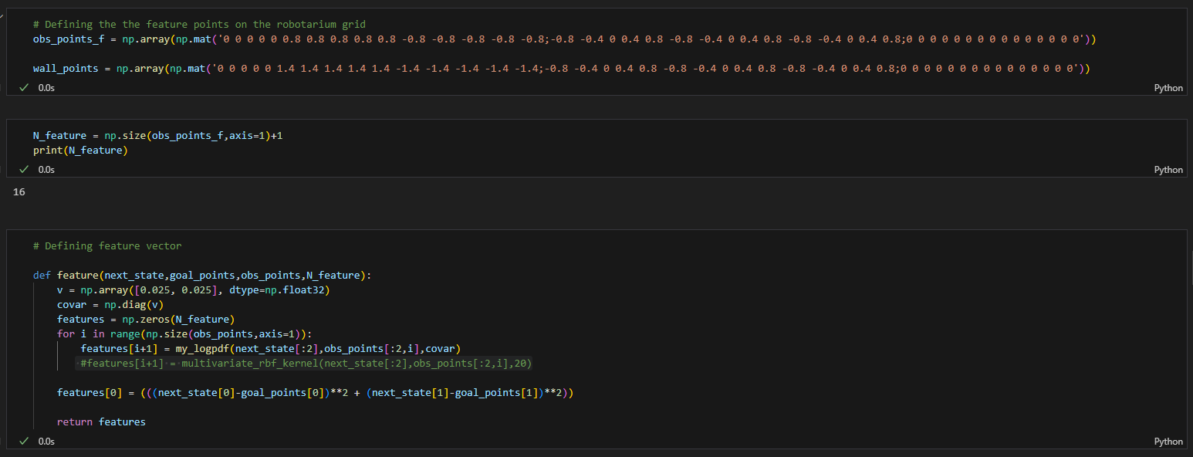

Slide 24
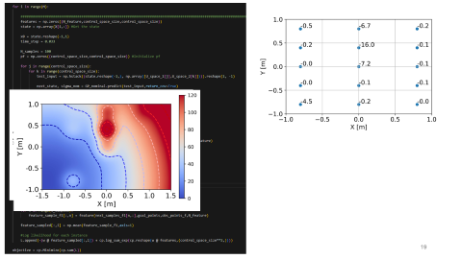
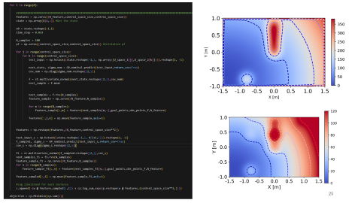
Belief Update
The optimization problem we solve for belief update:

Slide 25
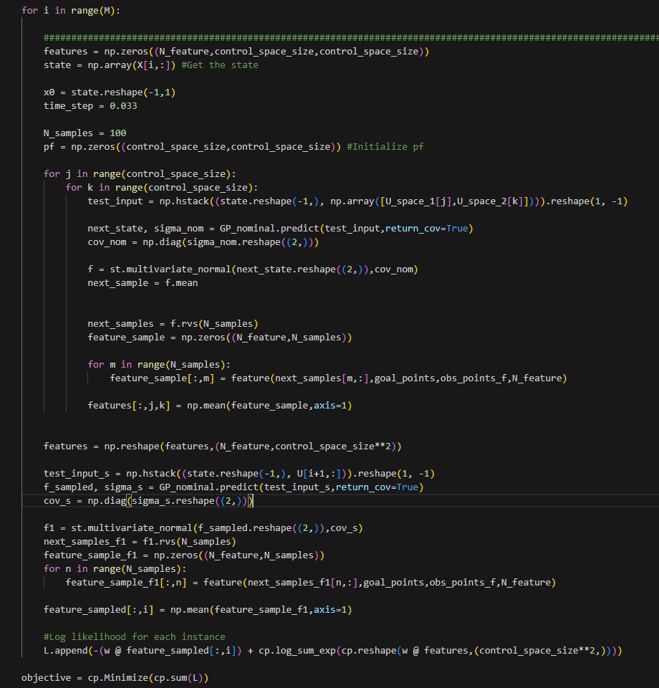
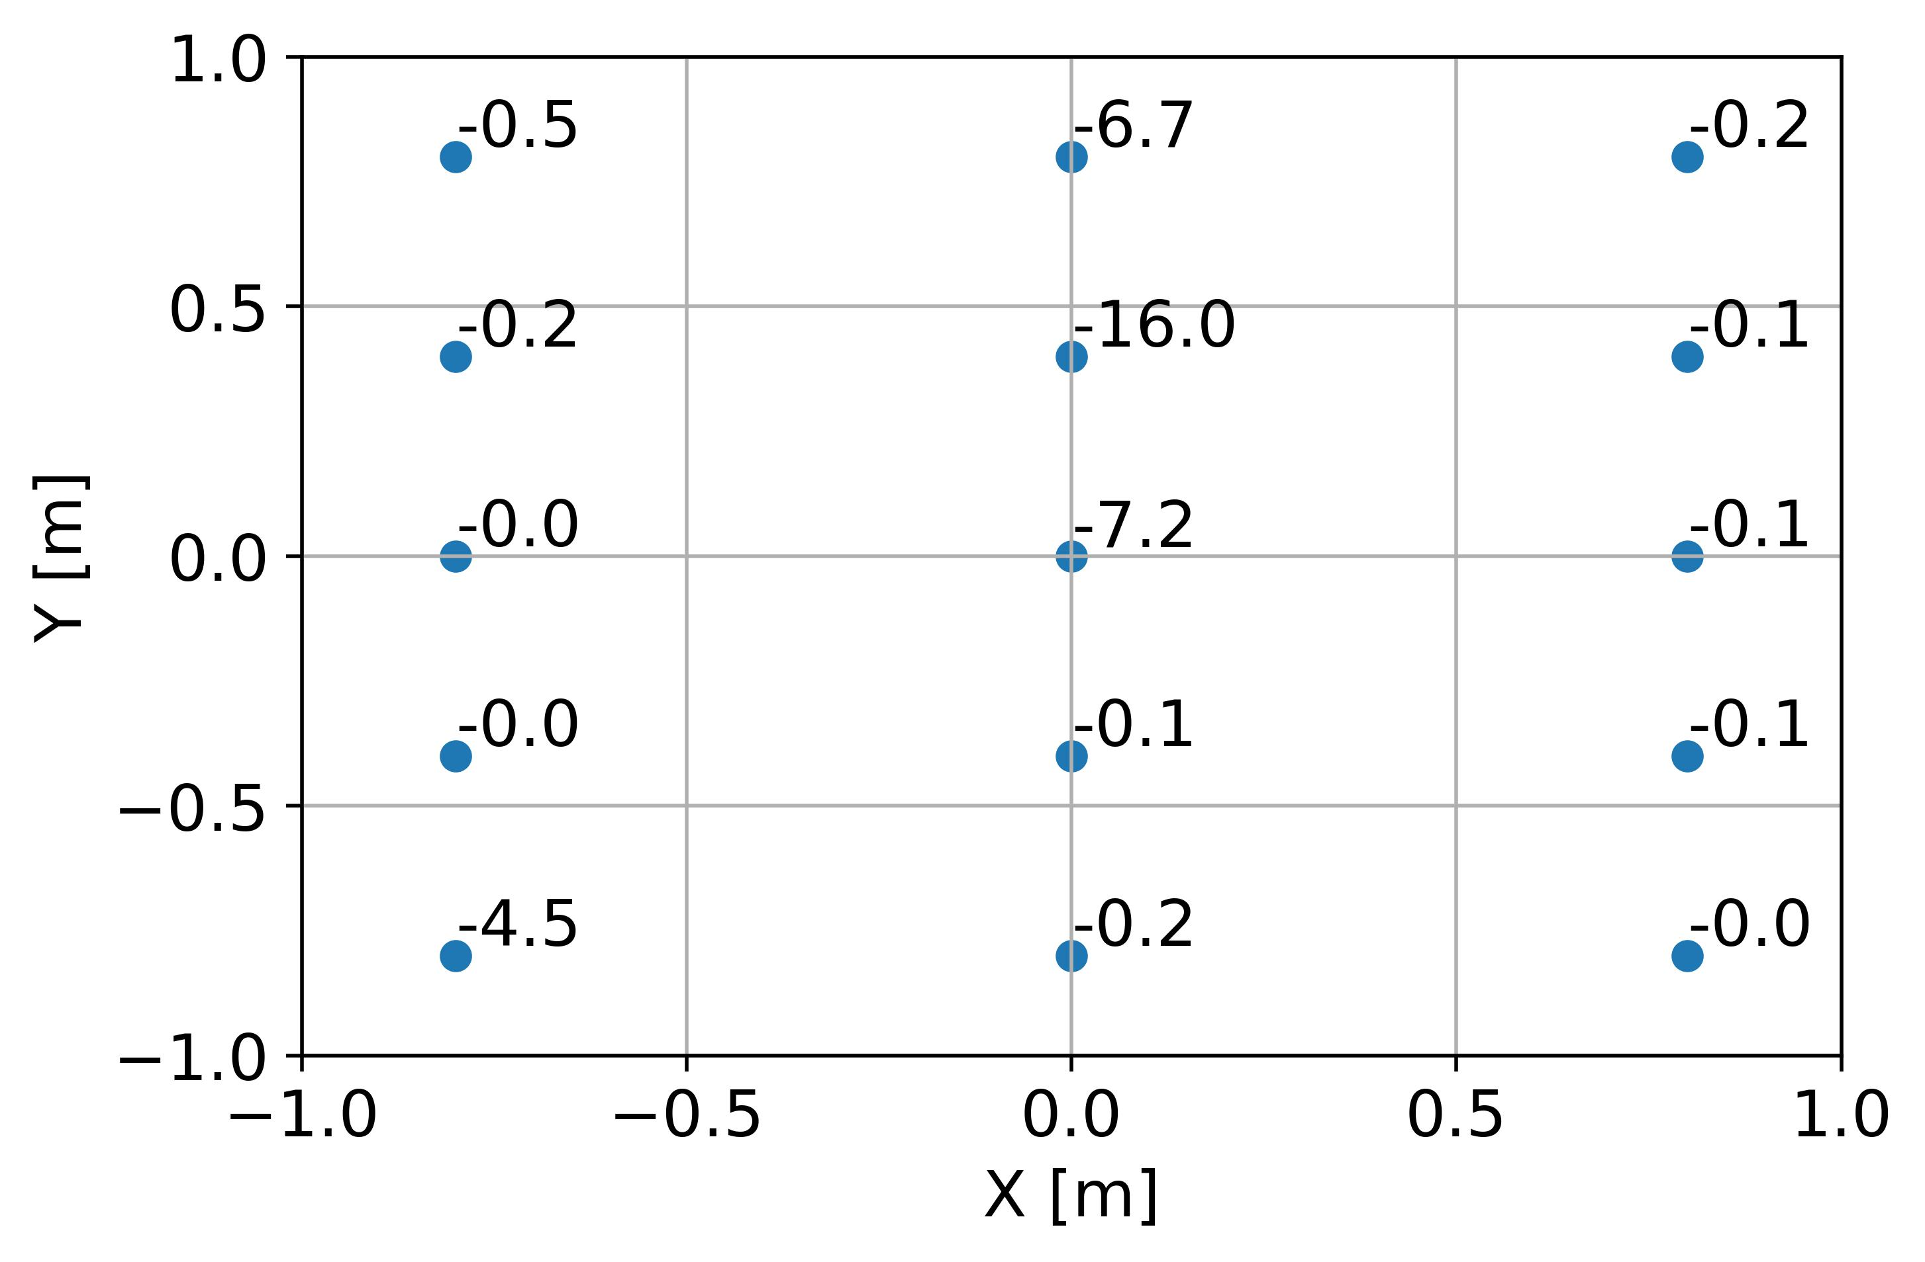
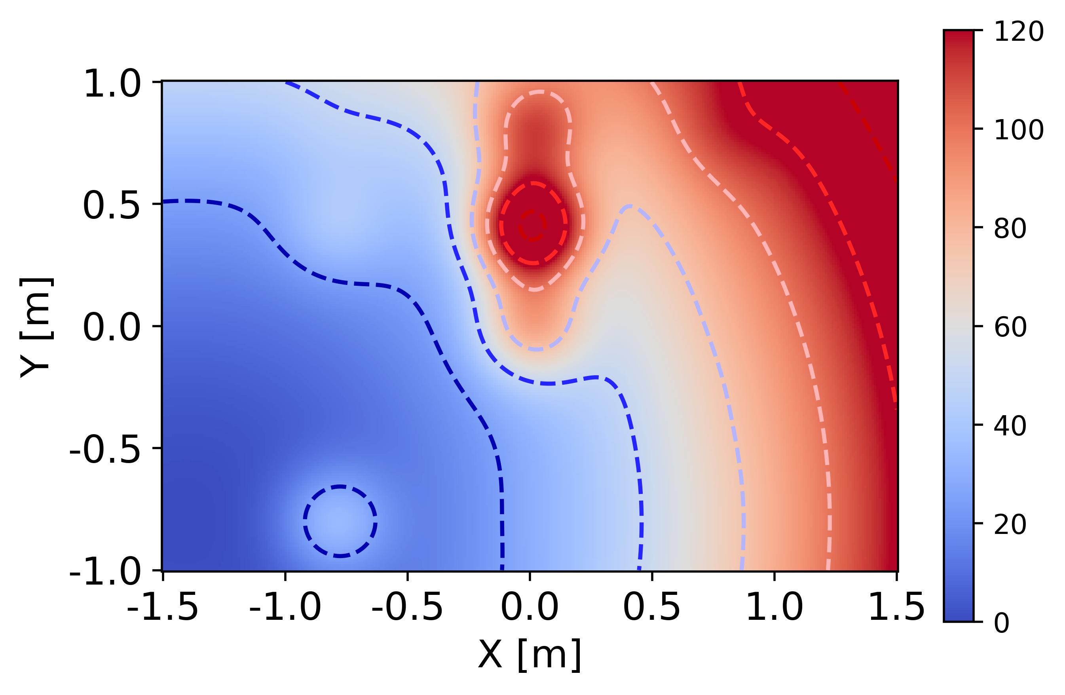

Slide 26
Recap
Robot Routing Simulation Code Structure
Belief Update Code Structure
Define Global Variables and Action Space
Define Global Variables and Action Space
Load Trained Dynamics Model
Load Trained Dynamics Model and Expert Agent Data
Define Cost Function and Features
Define Cost Features
Policy Computation
Compute Feature Expectation
Robot Routing Task and Visualization
Formulate and Solve Optimization Problem
Store state input data
Obtain Reconstructed Cost

Slide 27

Let’s now discuss the implications of DR-FREE
Code available at: https://tinyurl.com/yckdhmdt
hjesawada@unisa.it

